Slide 1
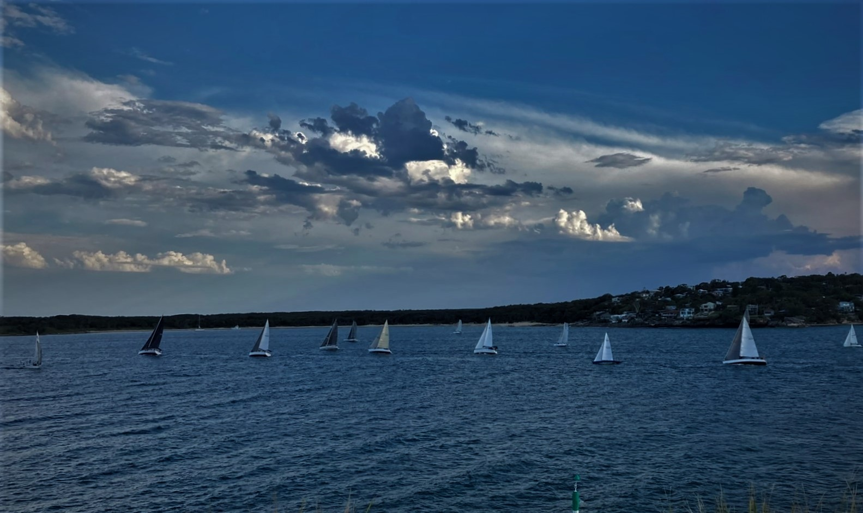
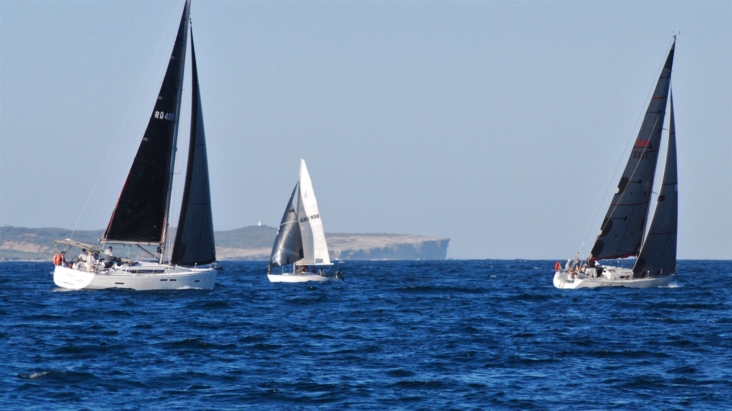
Sailing Captain’s
“Report 2023-24”
Race Entries:
Wednesday afternoons 20
Wednesday Twilights 20
Sunday Racing 12
Membership
Members 135
New Boats (welcome)
Excelsior (East Coast 31) Pete Baxter/ Roy Toal
Jazz Bar ( Adams 10) Jared Macquart/Tony Landers
Midnight Magic Peter Fielder
1

Slide 2
Off & On Water Activities- Presentations
Off & On Water Activities
2

Slide 3
Off & On Water Activities- Twilight Christmas party
Off & On Water Activities
3

Slide 4
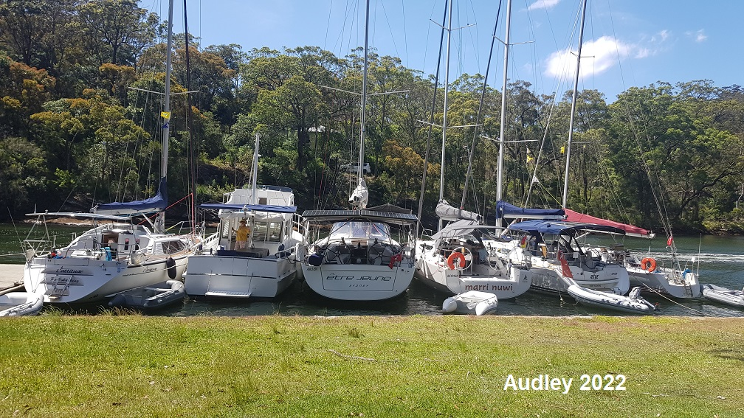
Off & On Water Activities- Audley Weekend
4

Slide 5
Off & On Water Activities-
Australia Day Novices Skippers race
Very hot, crazy Nor'westerley followed by near 40kt southerly just after race finish - 1st L'attitude; 2nd Tobruk- After party at John and Margarets

Slide 6
Off & On Water Activities-
Australia Day Novices Skippers race
Very hot, crazy Nor'westerley followed by near 40kt southerly just after race finish - 1st L'attitude; 2nd Tobruk

Slide 7
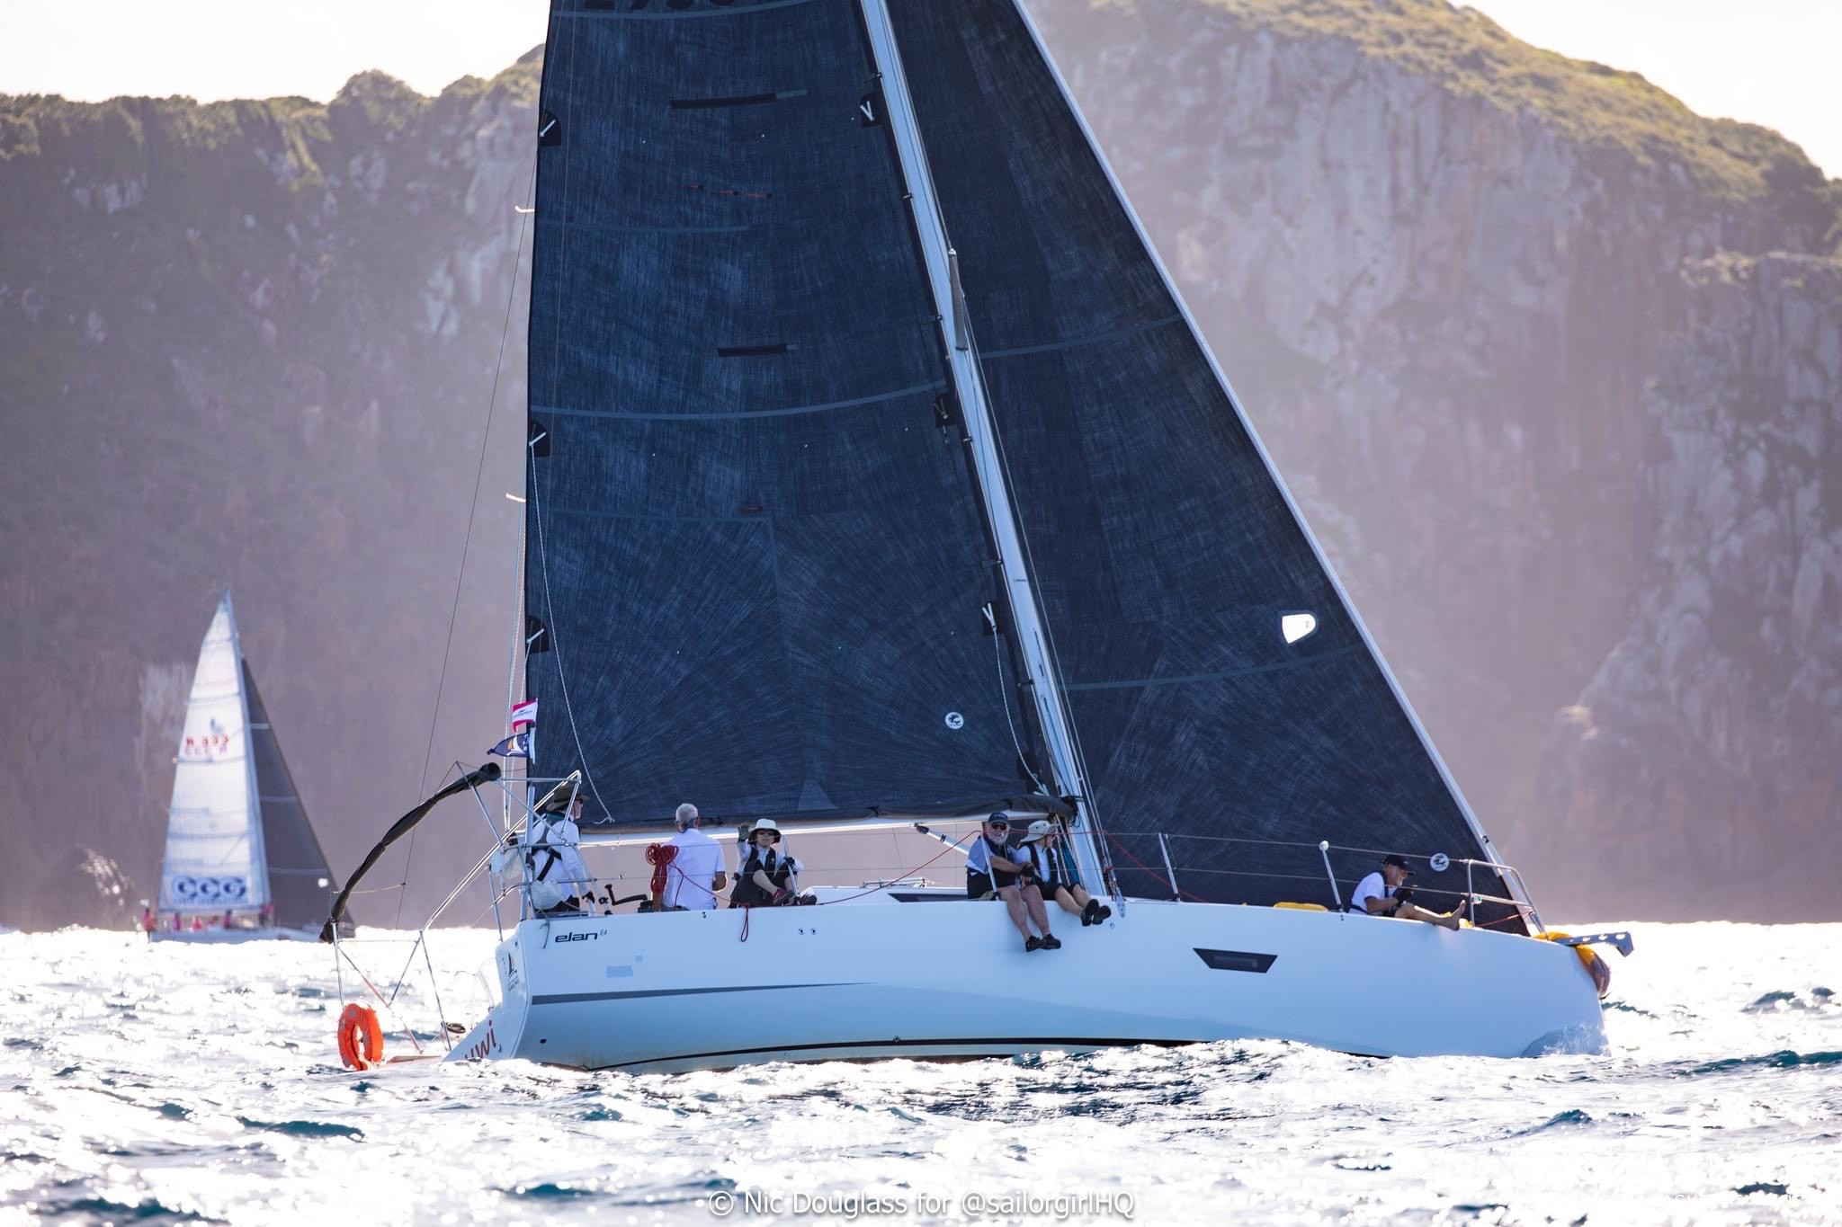
Port Stephens Regatta- April Yknot- sailed in Division 1 Etre Jeunne- sailed in Division 2 Jazz Bar- 4th place in Division 2 Marri Nuwi- 2nd place in Division 4 Majella – 3rd place in Division 4

Slide 8
Port Stephens Regatta

Slide 9
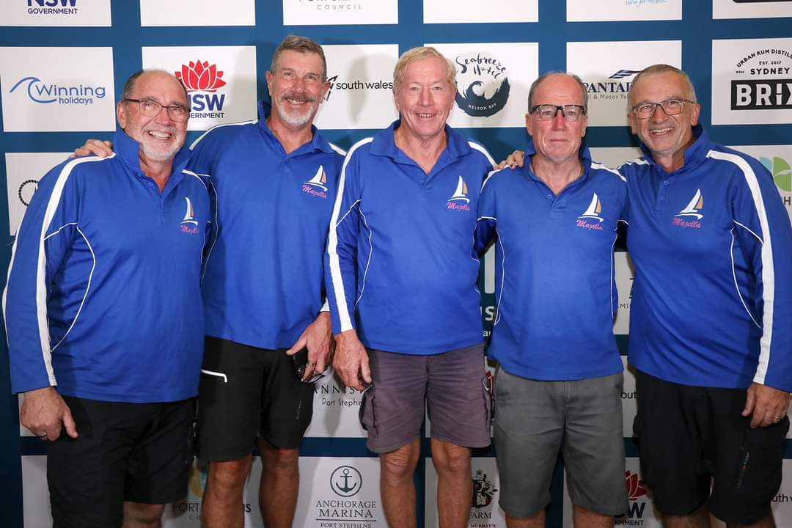
Port Stephens regatta
9

Slide 10
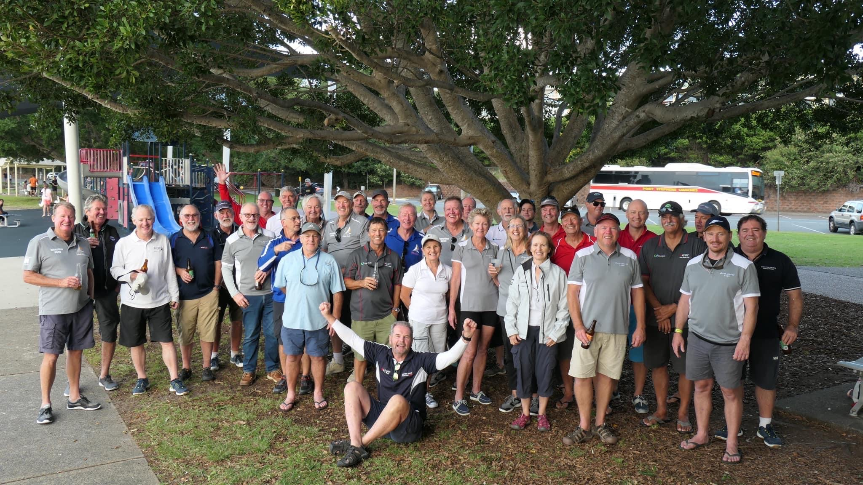
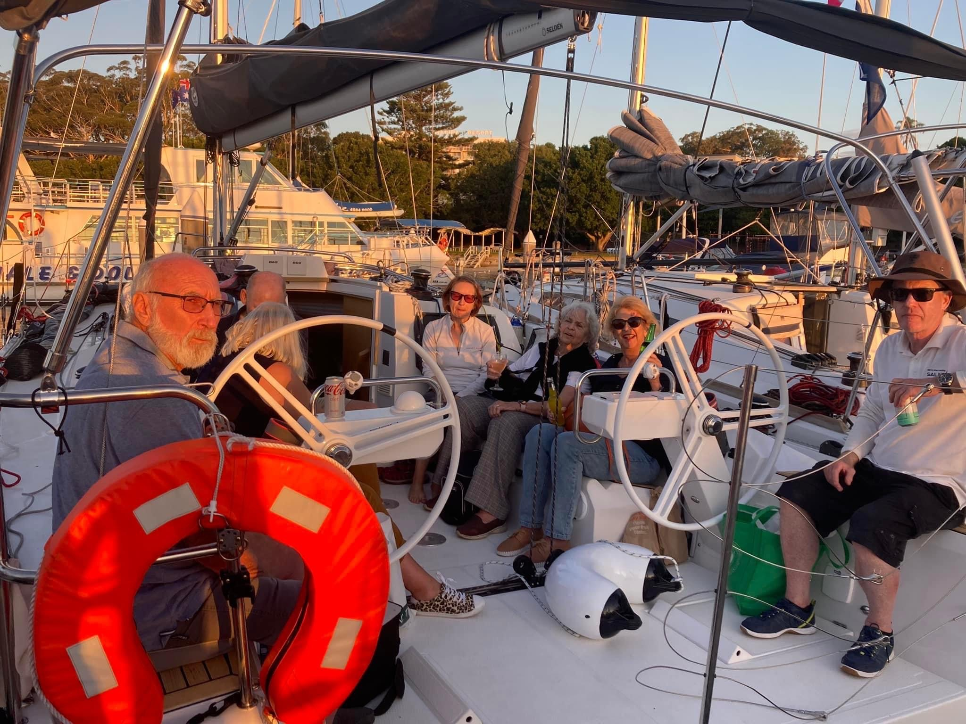
Port Stephens- RMYC PH & Cronulla Social

Slide 11
Thankyou
The successful year of sailing could’nt have happened without the help of our committee, volunteers, skippers, crew, and sponsors.
Committee members- John Barter Vice Captain, and race officer
- Tim Dodds – Treasurer
- Bill Dixon – Safety and Cruising
Volunteers - Ken Teifel; Wednesday Twilight presos
- David Newton, Tim Dodds; Presentation night & Xmas party
- Pete Corbett, Nick Wilson, Brett Parr; Wednesday courses
- Mike Wolf, Rob Milner, Glen Smith, Jim Lupton; Auditors
Alistair Rowe
Sailing Captain 2023/24

